Slide 1

Web app design
PROG 6212 Summative

Slide 2
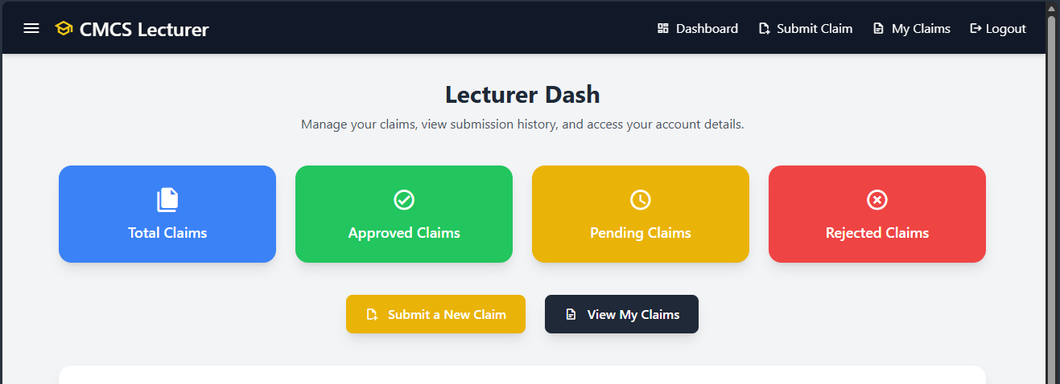

Slide 3
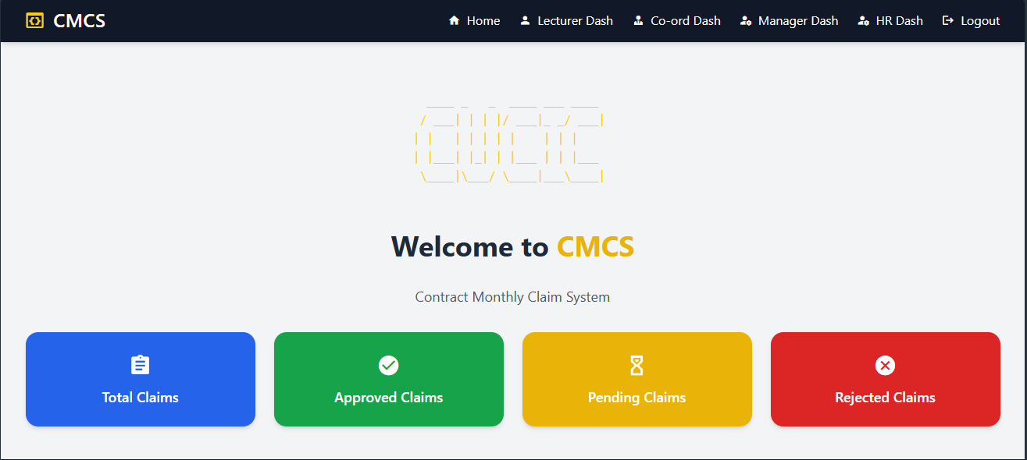
Contract Monthly Claim System (CMCS) –Report
The Contract Monthly Claim System’s (CMCS) operation, design, and goal are all covered in this presentation. The objective is to guide the user through the system in an understandable, organic, and user-friendly way, emphasizing its functions, the ways in which various users interact with it, and the thinking behind the selection of particular technologies throughout development. By providing lecturers, coordinators, managers, and HR with an organized and dependable method of handling monthly work claims, the CMCS is intended to address a practical administrative issue for organizations.

Slide 4
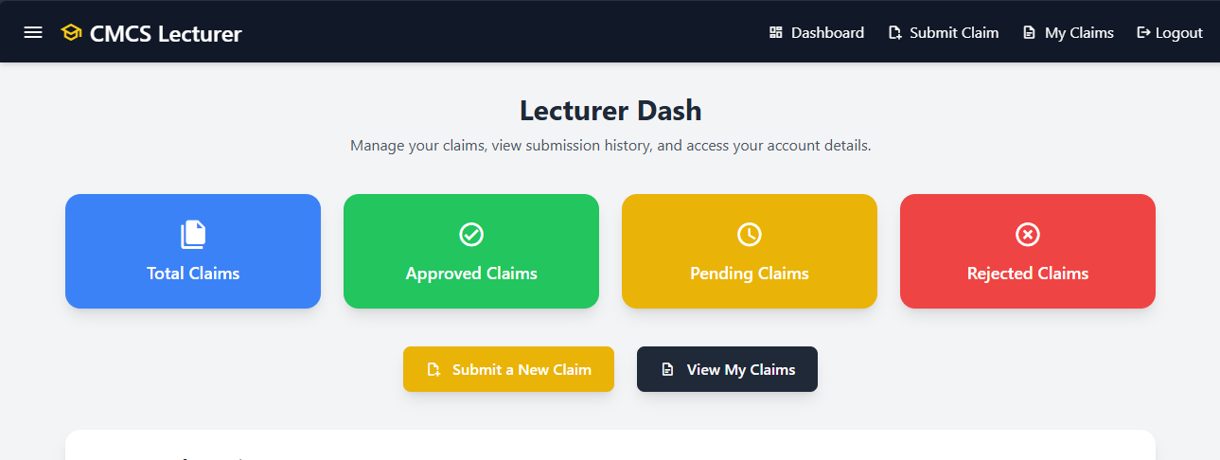
Purpose of the Web App
To modernize and simplify the lecturer claim process and experience is the main goal of the CMCS. Monthly claims are often processed by hand using spreadsheets, emails, paper forms, and irregular approval procedures. Delays can come about because of human error which is common or that there is miscommunication from relevant parties. Misplaced documents, and unneccessary efforts for administrative staff come from old school ways of lecturers or any staff member to traditionally submit a claim, is a result from this. But the CMCS web app helps to change that.

Slide 5
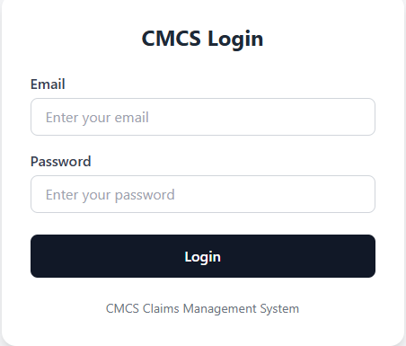
Purpose cont.
- By creating a organized ,single digital platform where lecturers can quickly file claims and attach papers, CMCS resolves these problems.
- It is simple for managers and coordinators to take a look , accept, or reject the claims.
- HR is able to produce accurate payroll records for every month.
- The entire procedure becomes simple, audit-friendly, and very easy to trace.
To put it shortly, CMCS gives the monthly claim workflow structure, automation, and control.

Slide 6
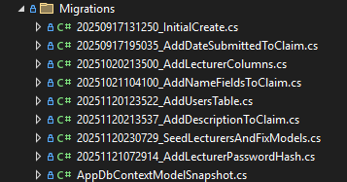
System and TOOLS
A selection of modern web technologies were selected for dependability, scalability, and ease of development, and they were used in the development of this CMCS web app.
Entity Framework Core is used to communicate with the SQL database. Instead of writing manual SQL queries, EF Core handles data mapping for.
Migrations folder with the relevant table data ,which helps the web app with fetching data for different functionality

Slide 7
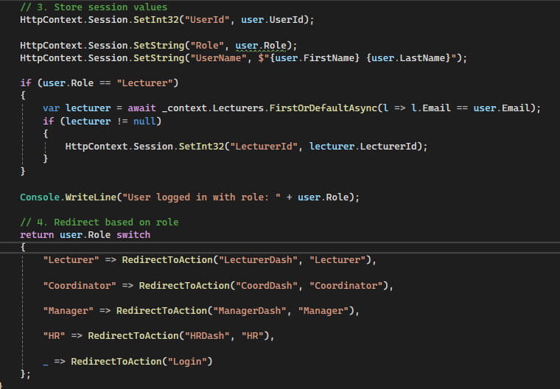
The SQL server is used to store everything like, users, lecturer details, claims, roles, and approval statuses. And for authentication of the throughout the web app, I made use of sessions which is responsible for keeping track of logged-in users. This ensures that each user only sees what their role allows. This is managed by having a Login method , so that once a user is logged in they do what they are authorized to do the they logout. For example a lecturer can only create a claim , they are not allowed to also then approve a claim, and that is managed through sessions.

Slide 8
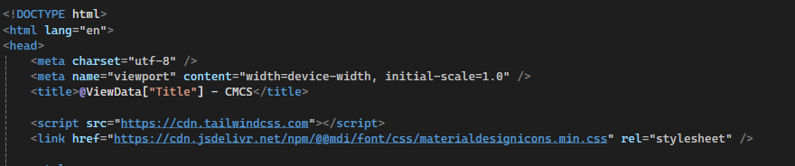
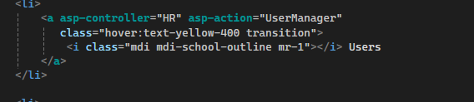
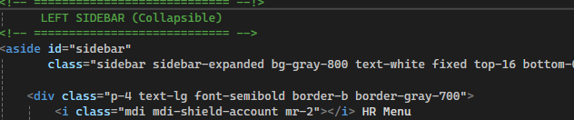
• Tailwind CSS & Material Design Icons was used so that I could have a clean, modern, and responsive UI design.
• File Uploading System – Allows lecturers to submit proof documents such as PDFs, Word, or Excel files.
• Role-Based Navigation – Each role (Lecturer, Coordinator, Manager, HR) receives a custom dashboard layout to guide them through their responsibilities

Slide 9

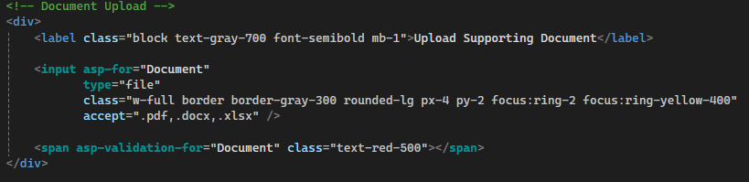
Role Based navigation
File uploading system

Slide 10

VIEWS
Lecturer Dashboard:
This acts as the lecturer's home screen. It offers a look into into claim statuses and shortcuts to commonly used actions.
• Submit Claim – Is used to allow lectures to submit their claims. The Lecturer would enter their hours worked, add some notes, and upload supporting documents then that’s their claim done.
• My Claims – Is used to show lecturers all their claims, including their status of completion, whether they are still pending, approved, or rejected. Each claim includes detailed timestamps.

Slide 11
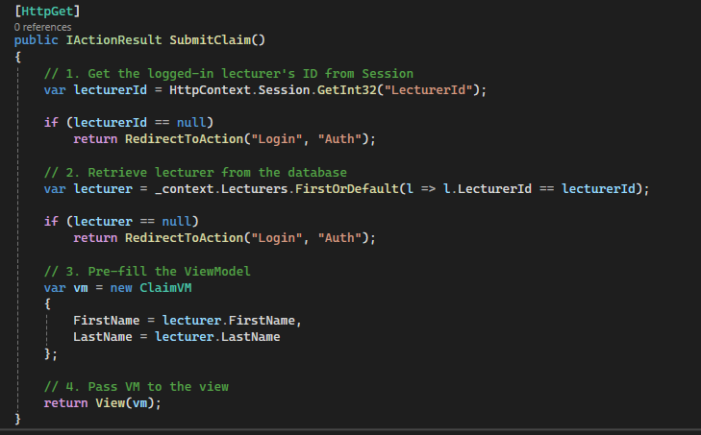

Slide 12
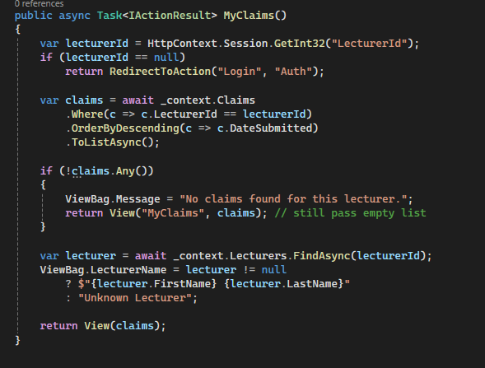
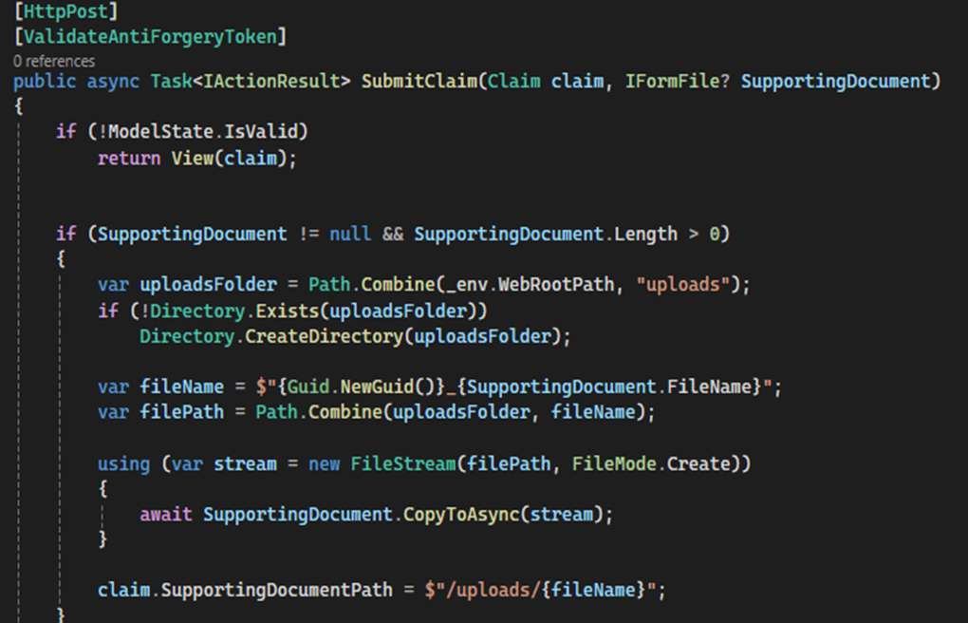

Slide 13
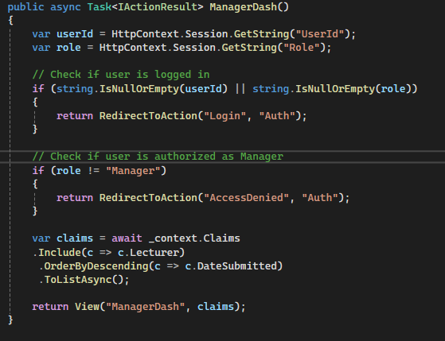
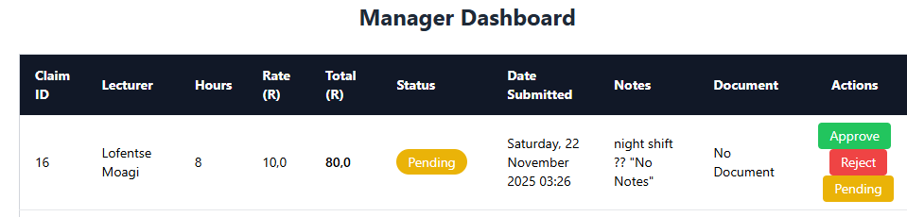
• Manager Dashboard: Similar to the coordinator’s view but with extended authority for final review.
• Filtering Options – Managers can switch between Pending, Approved, or Rejected claims to easily manage high volumes of submissions.

Slide 14
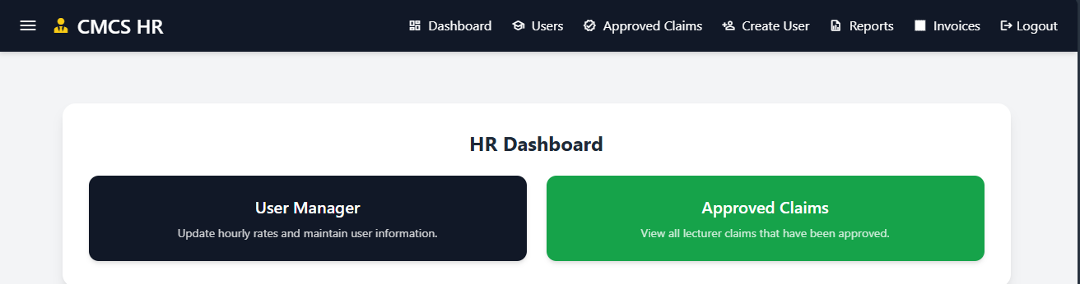
• HR Dashboard: This is to give the HR team a broad overview of the systems activity and of the approved claims.
• User Manager: HR can add new lecturers, coordinators, managers, and HR members.
• Reports: HR can generate filtered date‑range reports for payroll processing.
• Invoices: A dedicated area for financial recordkeeping linked to completed claims.

Slide 15
Key features
Secure Login – Password hashing ensures user credentials remain protected.
Session Storage – After login, sessions store user IDs and roles to control navigation.
EF Core Include() – Allows the system to load lecturer details directly with claims.
Upload Validation – Ensures only valid document types are accepted.
Role-Based Views – Each dashboard is generated dynamically based on the user’s role.
Approval Workflow Logic – Claims transition smoothly across statuses through clean controller actions.
Youtube link: https://youtu.be/h61cbrlTth8

